Slide 1
SI 506: Programming I
Winter 2022
Prologue
Anthony Whyte <arwhyte@umich.edu>
Lecturer III, School of Information
715 N. University Ave, Ann Arbor, MI 48109
Roumanis Square, 2nd floor (“the loft”)

Slide 2

Welcome
go blue

Slide 3
Prerequisites
none 😉
no prior programming
experience is required

Slide 4
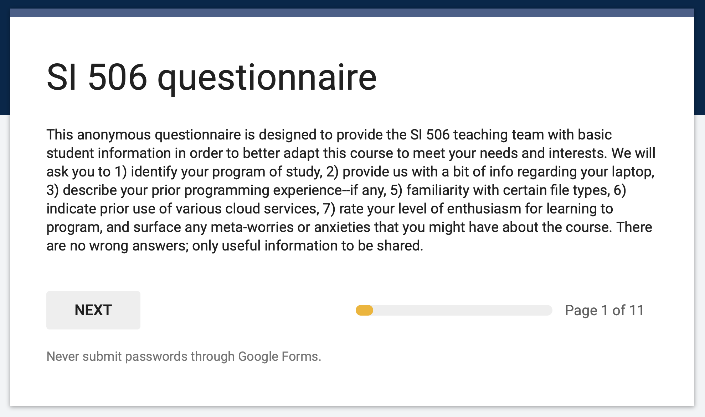
Questionnaire
No wrong answers

Slide 5

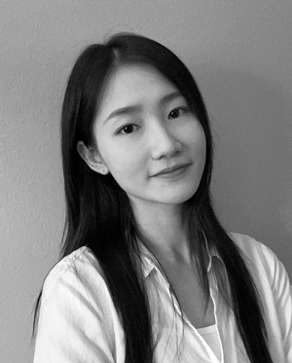
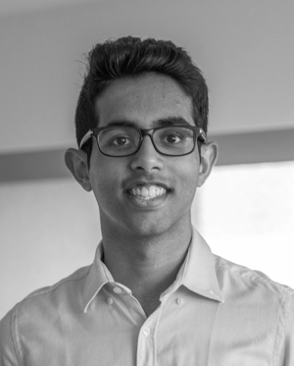
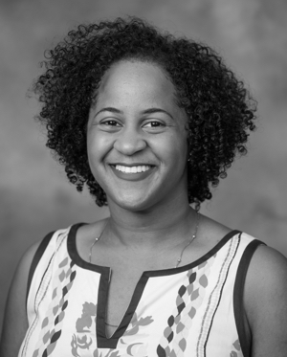
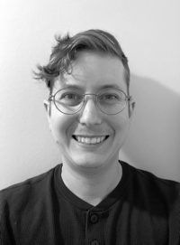
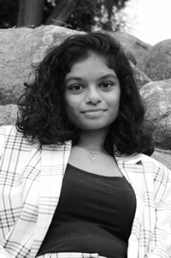
Teaching Team
https://www.si506.org/team/
Anthony Whyte
Yash Kamat
Tasha Torchon
Yaoqi Liao
GSI
GSI
GSI
Joshua Horowitz
Swathi Komarivelli
IA
IA

Slide 6
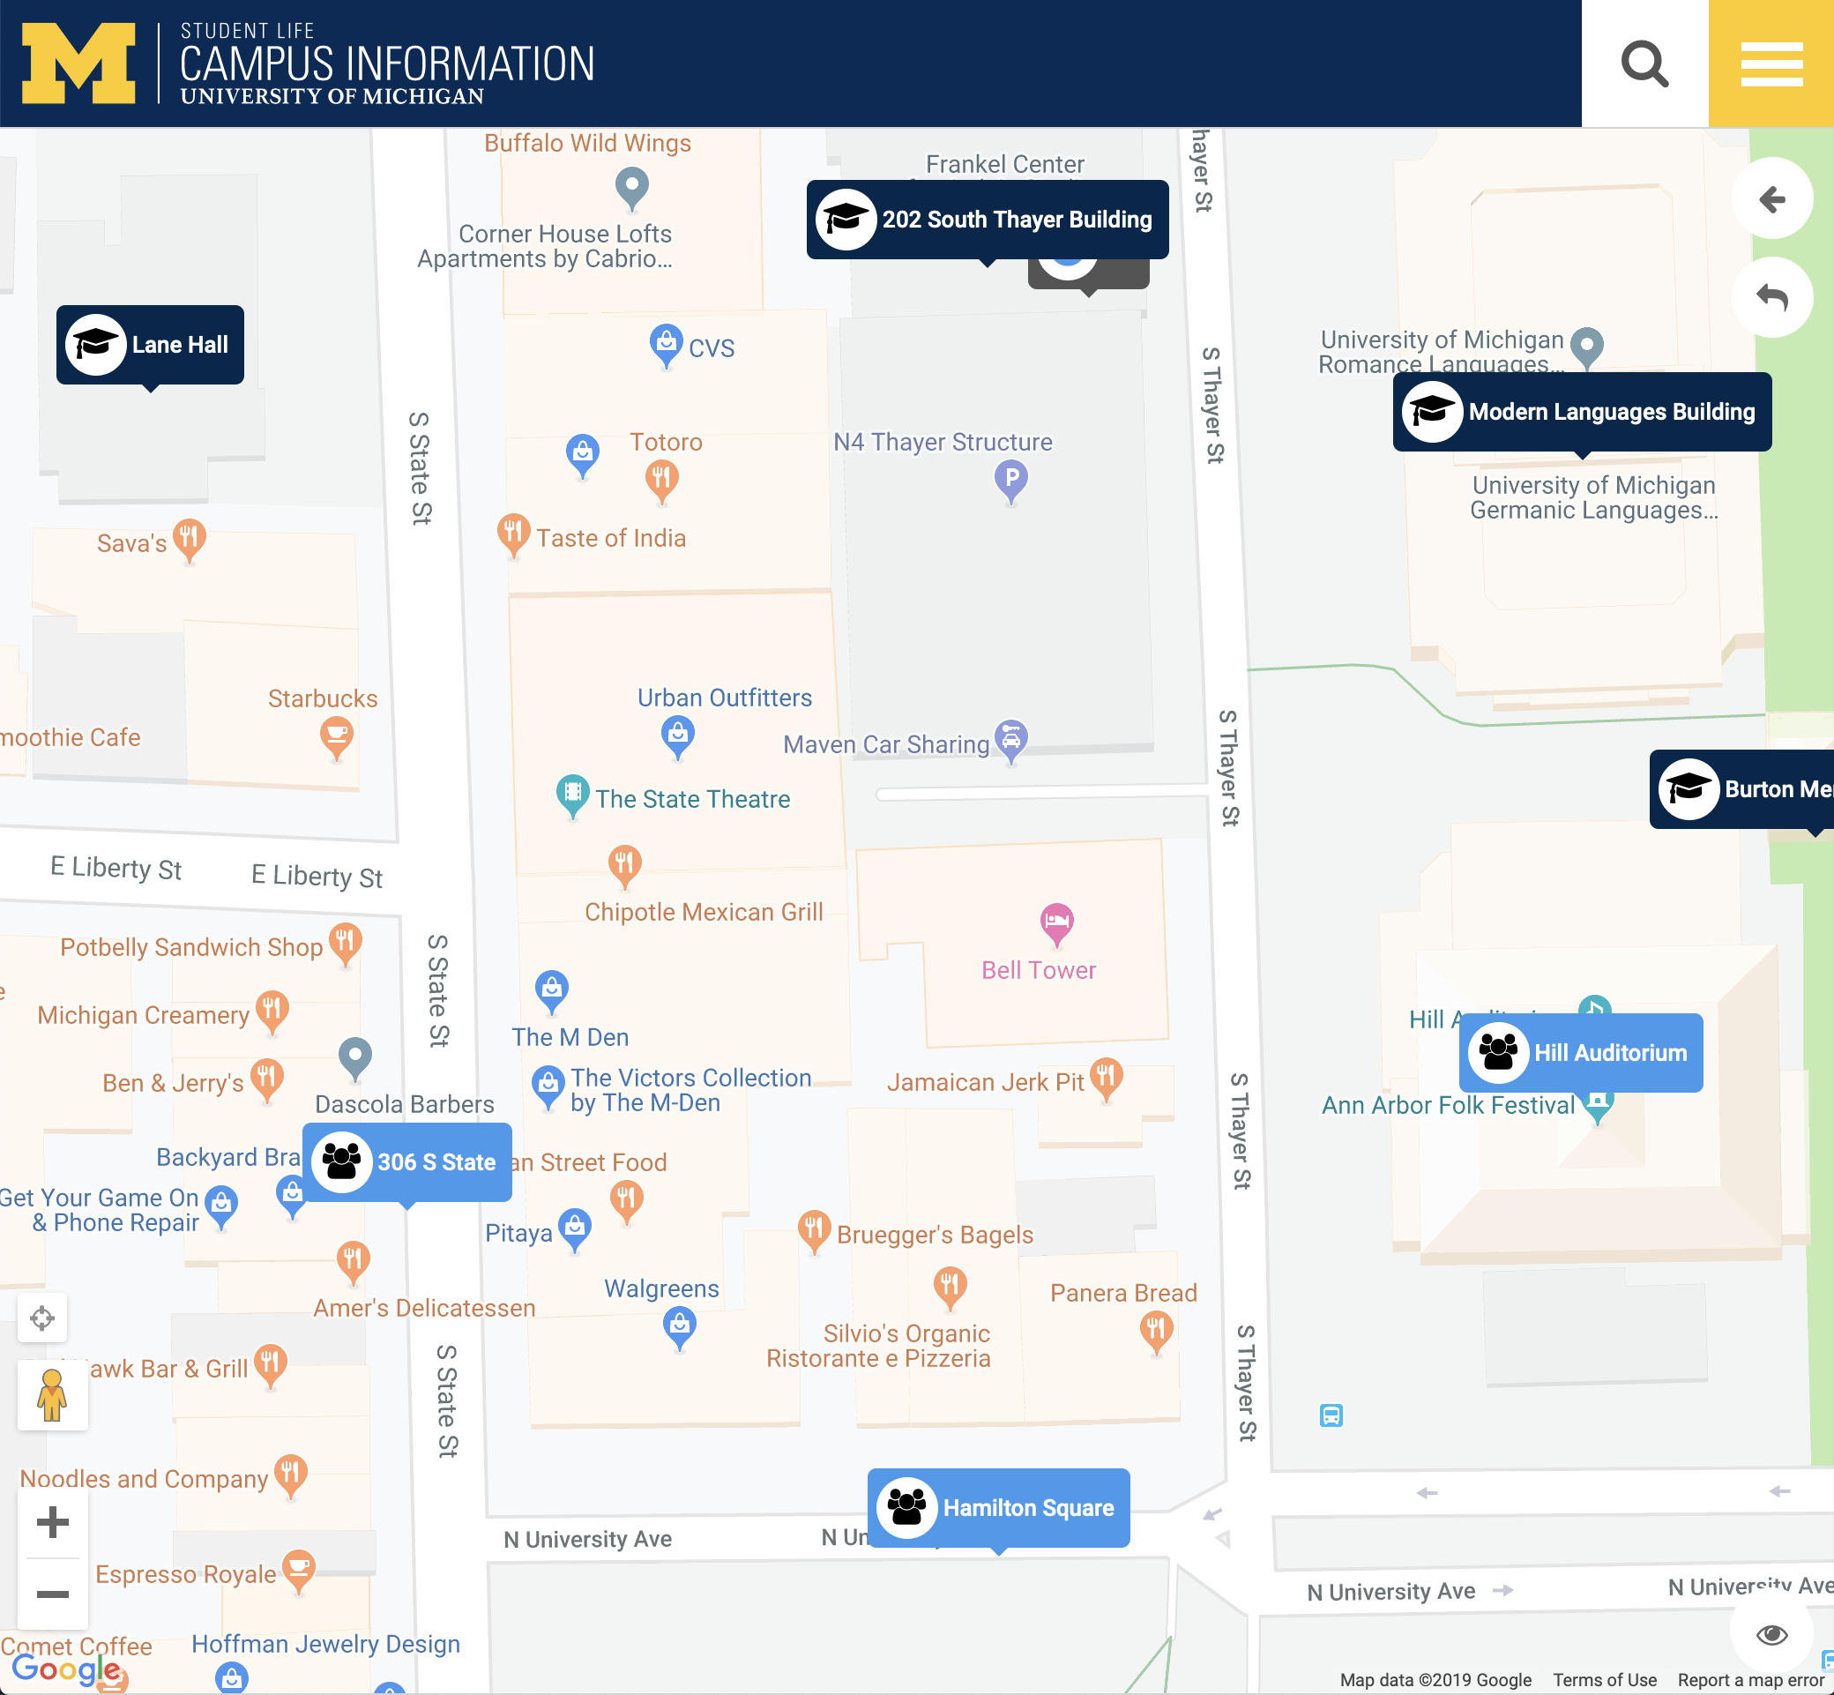
arwhyte: office
office: Roumanis Square, 2nd floor, UMSI Loft, Rm 201H

Slide 7
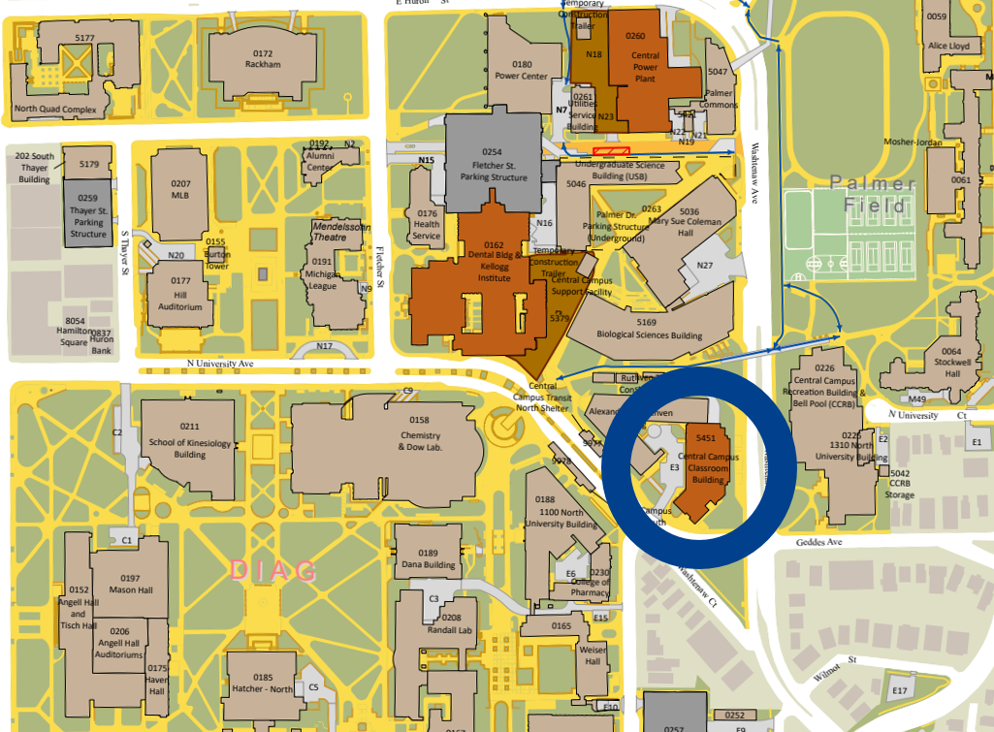
Central Campus Classroom Building
CCCB location (open Winter 2022)

Slide 8
Central Campus Classroom Building
CCCB exterior

Slide 9
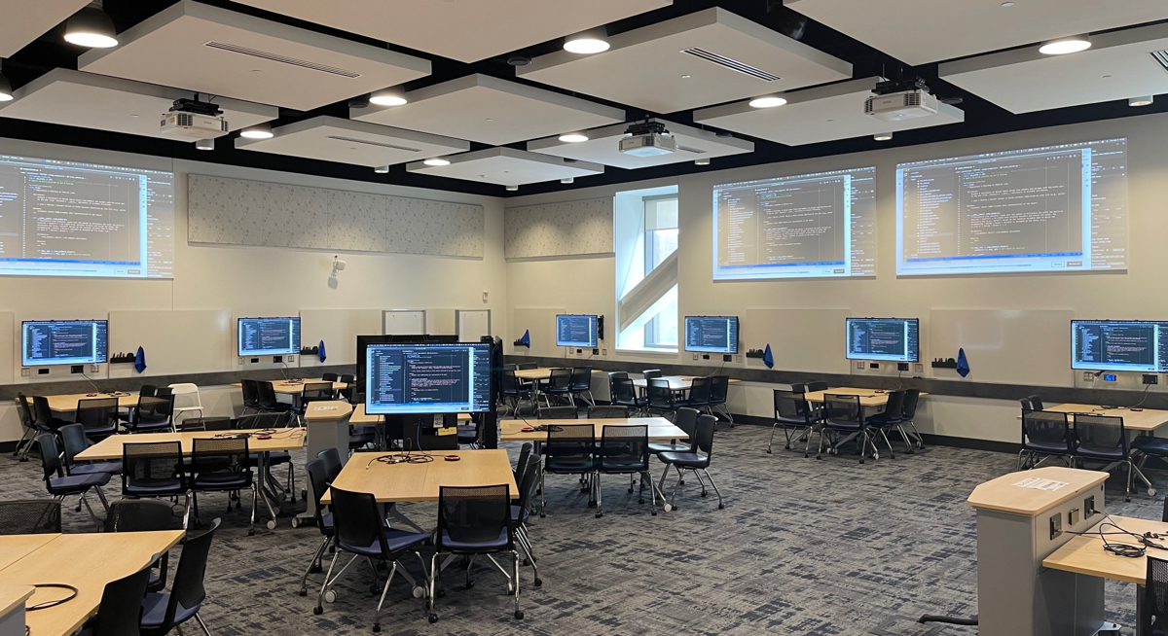
2460 CCCB
our classroom

Slide 10
teaching & learning

Slide 11
Communication channels
Study
groups
Lecture
Lab
Week X
def fib(n):
a, b = 0, 1
while a < n:
print(a, end=' ')
a, b = b, a+b
print()
fib(1000)
def fib(n):
a, b = 0, 1
while a < n:
print(a, end=' ')
a, b = b, a+b
print()
fib(1000)
def fib(n):
a, b = 0, 1
while a < n:
print(a, end=' ')
a, b = b, a+b
print()
fib(1000)
Office
Hours
U-M
Slack
email

Slide 12
Problem-solving (programmatic)
decompose a problem into subproblems
Problem Space
1
2
Divide problems into sub-problems.
Work iteratively, moving from general solutions to specific solutions.
For each sub-problem write working code.
Solve each sub-problem before proceeding to next problem.
3
4

Slide 13


Language of instruction
expressive, flexible, general purpose, beginner-friendly
scripting,
data analysis,
artificial intelligence,
scientific computing,
web development

Slide 14
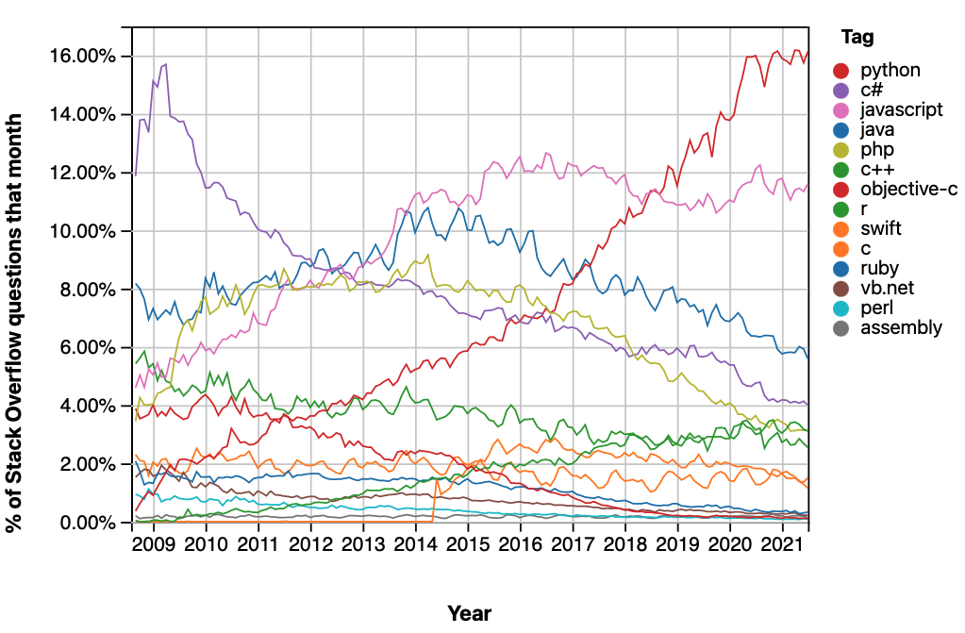
Gauging interest in Python
stackoverflow trends (Q&A):

Slide 15
Topics
programming fundamentals
Syntax /
Semantics
Data Structures
Iteration
Control
Flow
Functions
variables
objects
operators
expressions
statements
strings
lists
tuples
dictionaries
nested structures
Definite iteration
Indefinite iteration
Accumulation
Comprehensions
conditional execution
(if-elif-else)
truth value
built-in
user-defined
main()
parameters
return value
Files
Web
API
Modules
Documentation
Errors
read / write
file objects
.txt, .csv, .json
package install (pip)
HTTP GET requests
import
modular design
comments
Docstrings
README
tracebacks
debugging

Slide 16
Write programs
modular, reusable code
import json
import requests
ENDPOINT = 'https://swapi.py4e.com/api'
def create_person(response):
def get_resource(url, params=None)
def write_json(filepath, data):
def main()
response = get_resource(f"{ENDPOINT}/people/", {'search': 'rey'})
rey = create_person(response)
print(f'Rey = {rey}')
write_json('rey.json', rey)
if __name__ == '__main__':
main()

Slide 17
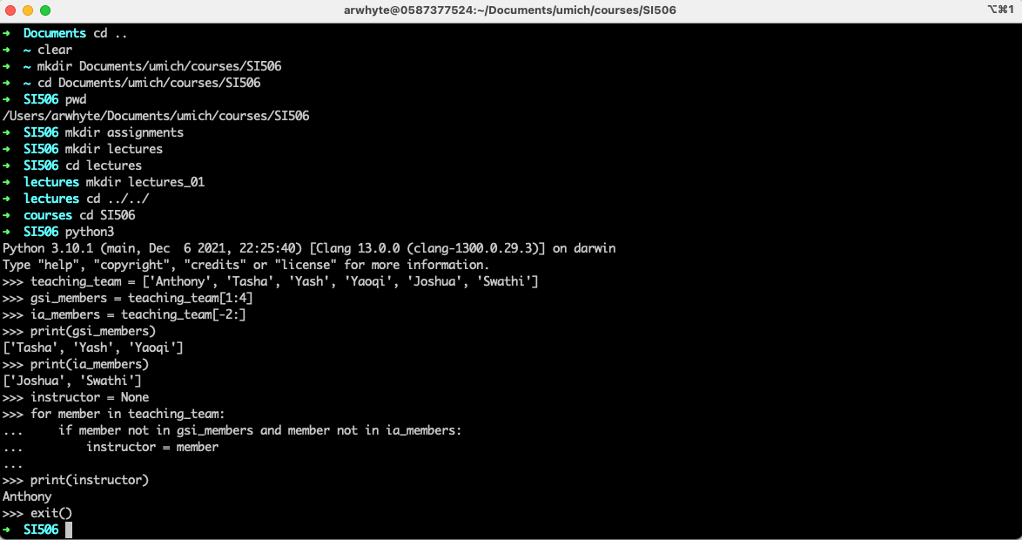
The terminal
interact with your operating system / file system

Slide 18

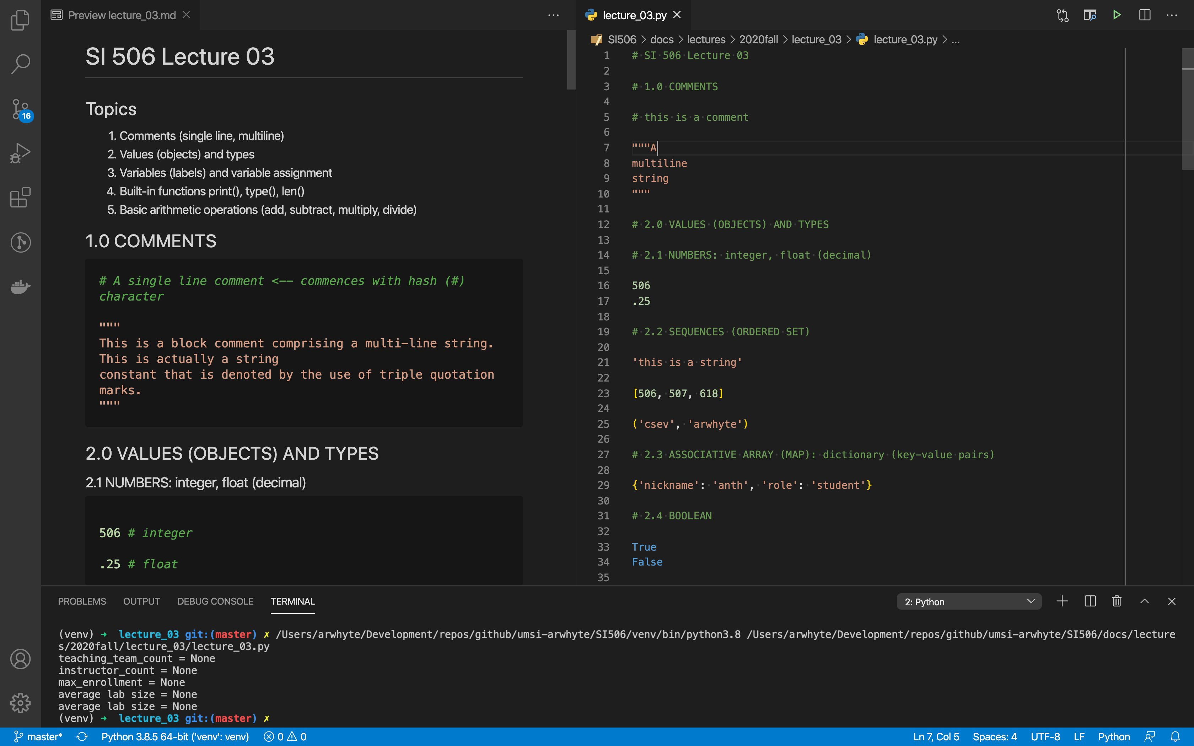
Visual Studio Code
https://code.visualstudio.com/

Slide 19
infrastructure

Slide 20
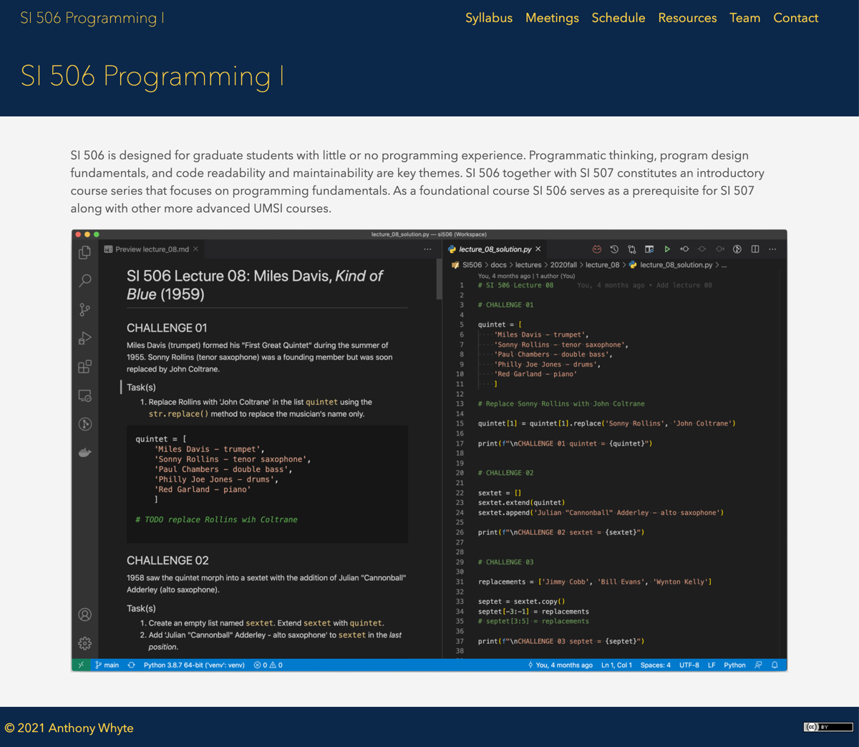
si506.org
syllabus, meetings, schedule, resources, team

Slide 21

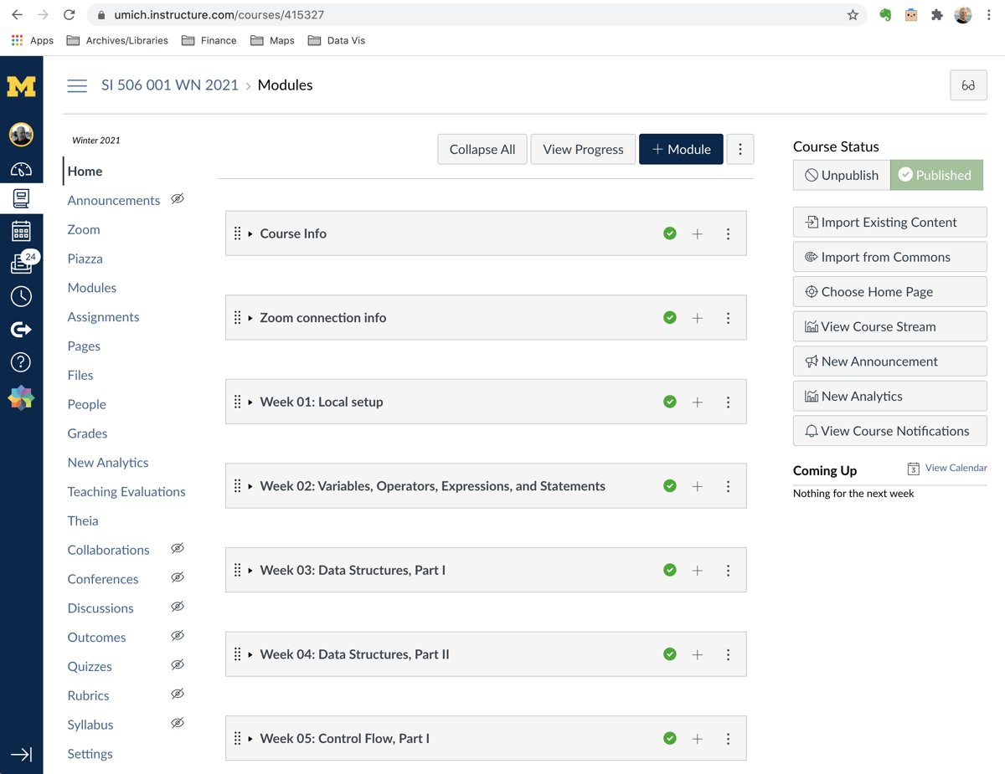
Canvas LMS
Modules: Zoom info, weekly readings, assignments

Slide 22
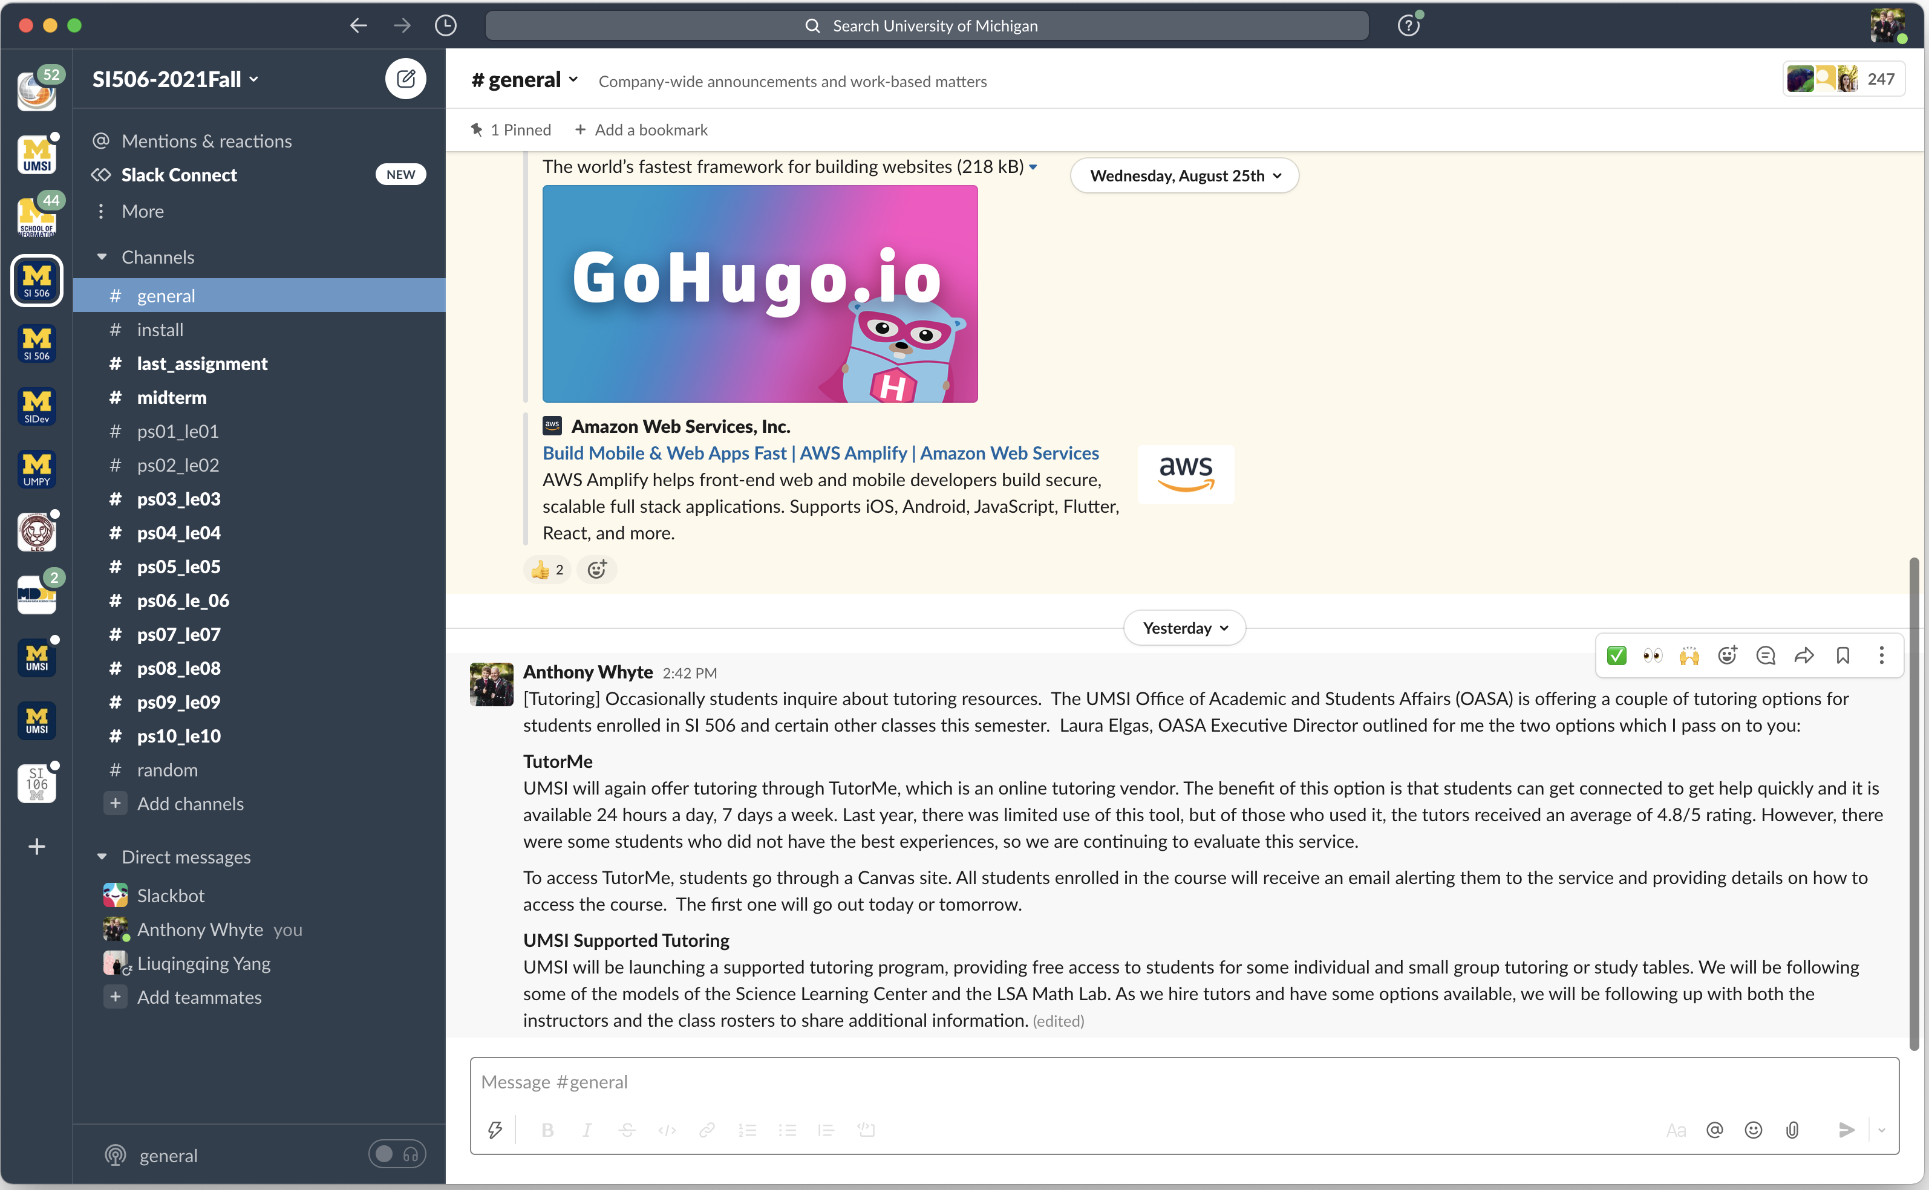
Slack
SI506-2021Fall workspace
signup instructions: https://si506.org/resources

Slide 23
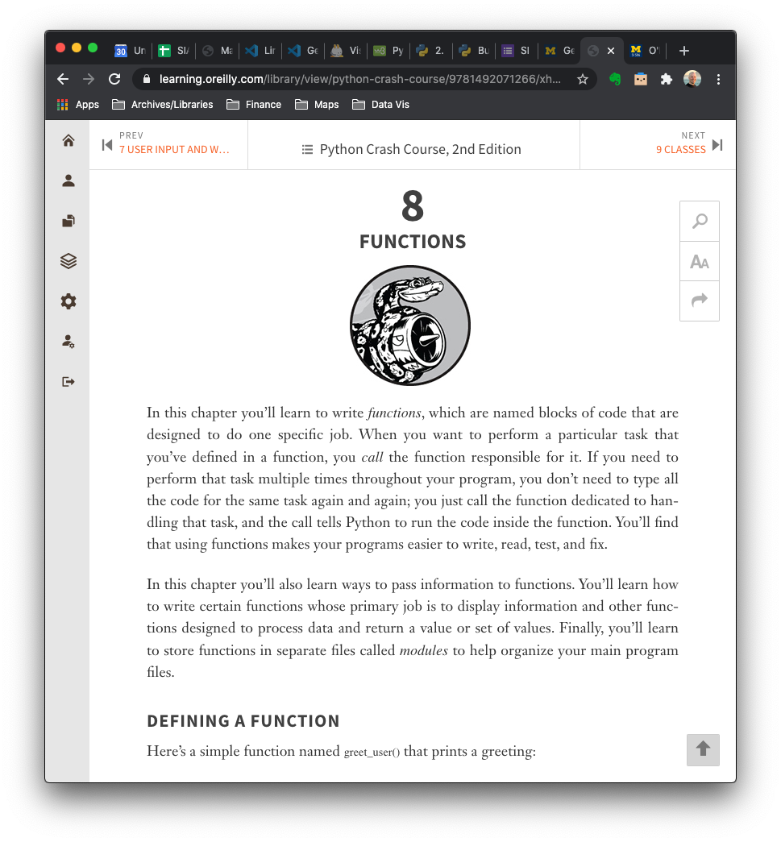
O’Reilly Learning Platform
Free school account
signup instructions: https://si506.org/resources

Slide 24
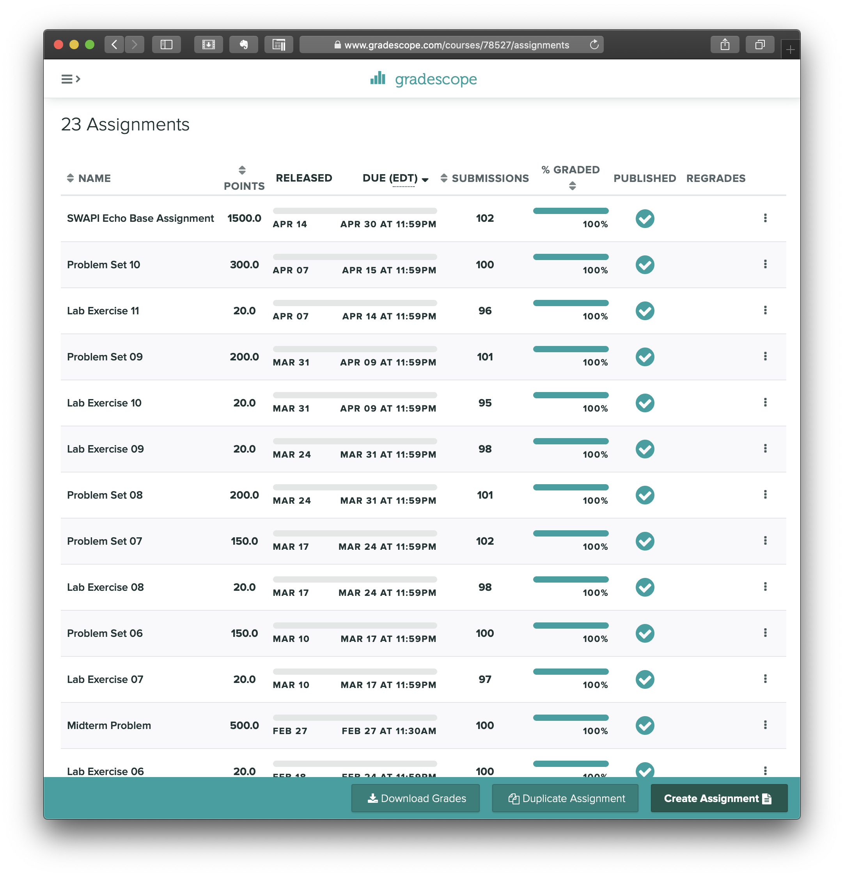
Gradescope
auto graded programming assignments

Slide 25
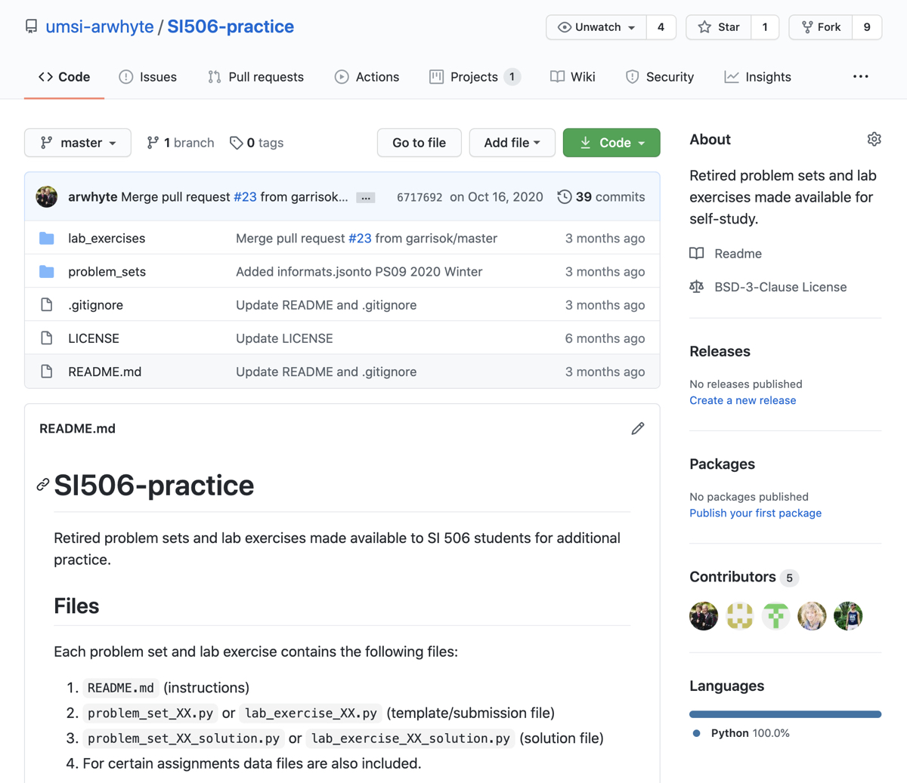
Github repo: SI506-practice
https://github.com/umsi-arwhyte/SI506-practice
practice problems

Slide 26
This week
deliverables
Review
(si506.org)
syllabus
meetings
schedule
resources
Activate
U-M Slack Account
U-M Zoom Account
O’Reilly School Account
Install
Python 3.10.1
VS Code + extensions
Take
Questionnaire

Slide 27
Suggested best practices
we recommend, you decide
Attend
lectures
labs
office hours
Watch
recordings
Post
Slack
Read
weekly readings
Practice
write code
Submit
assignments
(on time)

Slide 28
finis

Slide 29
Slide deck revisions
errata: corrections and other changes
Slide no(s). | Fix ver. | Description
 | v1p1

